Slide 1
QUDT Introduction
Quantities, Units, Dimensions and Types
May 20, 2025
Steve Ray, CEO QUDT.org
Ralph Hodgson, President QUDT.org
v5

Slide 2

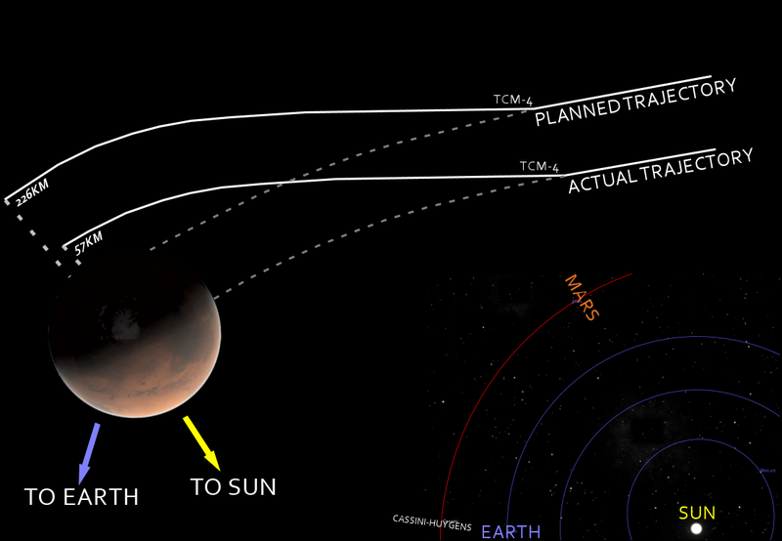
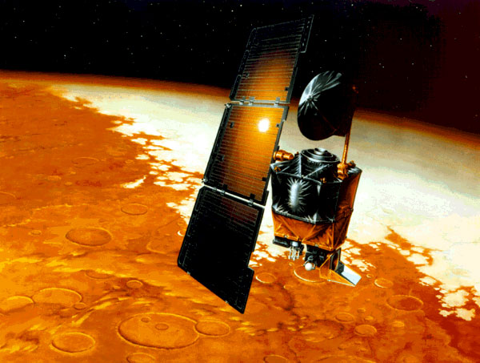
A key NASA Motivation
NASA's metric confusion caused Mars orbiter loss
Web posted at: 1:46 p.m. EDT (1746 GMT)
(CNN) -- NASA lost a $125 million Mars orbiter because one engineering team used metric units while another used English units

Slide 3
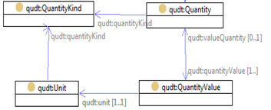
Machine-readable Metadata
“Thruster setting to Impulse with value 324.59 Newton-seconds”
Impulse
Thruster setting
Newton-second
324.59

Slide 4
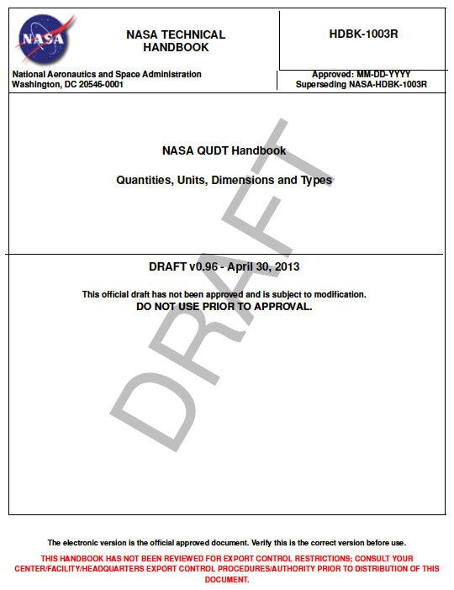
NASA Motivations For the Constellation Program (Return to Moon and Mars)
Model-based QUDT vocabularies and schemas expressed in W3C RDF and OWL standards.
Provided as a QUDT Handbook and Interoperable machine-processable tools (NExIOM)
Notes:
Consistency and compatibility of analyses and communication across:
inter-program,
inter-function,
inter-departmental and
inter-organizational activities;
Mitigation of errors and their associated impacts on:
Budgets,
schedules,
quality of deliverables and
mission safety.
Satisfying the life-cycle development and operational needs of the science and engineering communities;
Structured and web-based access to additional model-based QUDT information, tools and services.

Slide 5
NASA QUDT started with ISO-80000 standards
ISO-80000-01 2009 ISO 80000-1:2009 Quantities and units – Part 1: Generals
ISO-80000-01 2009/Cor 1:2011 ISO 80000-1:2009 Quantities and units – Part 1: General (Correction 1)
ISO-80000-02 2009 ISO 80000-2:2009 Quantities and units – Part 2: Mathematical signs and symbols to be used in the natural sciences and technology
ISO-80000-03 2006 ISO 80000-3:2006 Quantities and units – Part 3: Space and time
ISO-80000-04 2006 ISO 80000-4:2006 Quantities and units – Part 4: Mechanics
ISO-80000-05 2007 ISO 80000-5:2007Quantities and units – Part 5: Thermodynamics
ISO-80000-06 2008 IEC 80000-6:2008 Quantities and units – Part 6: Electromagnetism
ISO-80000-07 2008 ISO 80000-7:2008 Quantities and units – Part 7: Light
ISO-80000-08 2007 ISO 80000-8:2007 Quantities and units – Part 8: Acoustics
ISO-80000-09 2009 ISO 80000-9:2009 Quantities and units – Part 9: Physical chemistry and molecular physics
ISO-80000-09 2009/Amd 1:2011 ISO 80000-9:2009/Amd 1:2011
ISO-80000-10 2009 ISO 80000-10:2009 Quantities and units – Part 10: Atomic and nuclear physics
ISO-80000-11 2009 ISO 80000-11:2008 Quantities and units – Part 11: Characteristic numbers
ISO-80000-12 2009 ISO 80000-12:2009 Quantities and units – Part 12: Solid state physics
ISO-80000-13 2008 IEC 80000-13:2008 Quantities and units – Part 13: Information science and technology
ISO-80000-14 2008 IEC 80000-14:2008 Quantities and units – Part 14: Telebiometrics related to human physiology
ISO/DIS 80003-02 ISO/DIS 80003-2 Physiological quantities and their units – Part 2: Physics
ISO/DIS 80003-03 ISO/DIS 80003-3 Physiological quantities and their units – Part 3: Chemistry
ISO/NP 80003-02 ISO/NP 80003-7 Physiological quantities and their units – Part 7: Physicopharmacology
ISO/NP 80003-06 ISO/NP 80003-8 Physiological quantities and their units – Part 8: Chemopharmacology
ISO/NP 80003-08 ISO/NP 80003-8 Physiological quantities and their units – Part 8: Chemopharmacology

Slide 6
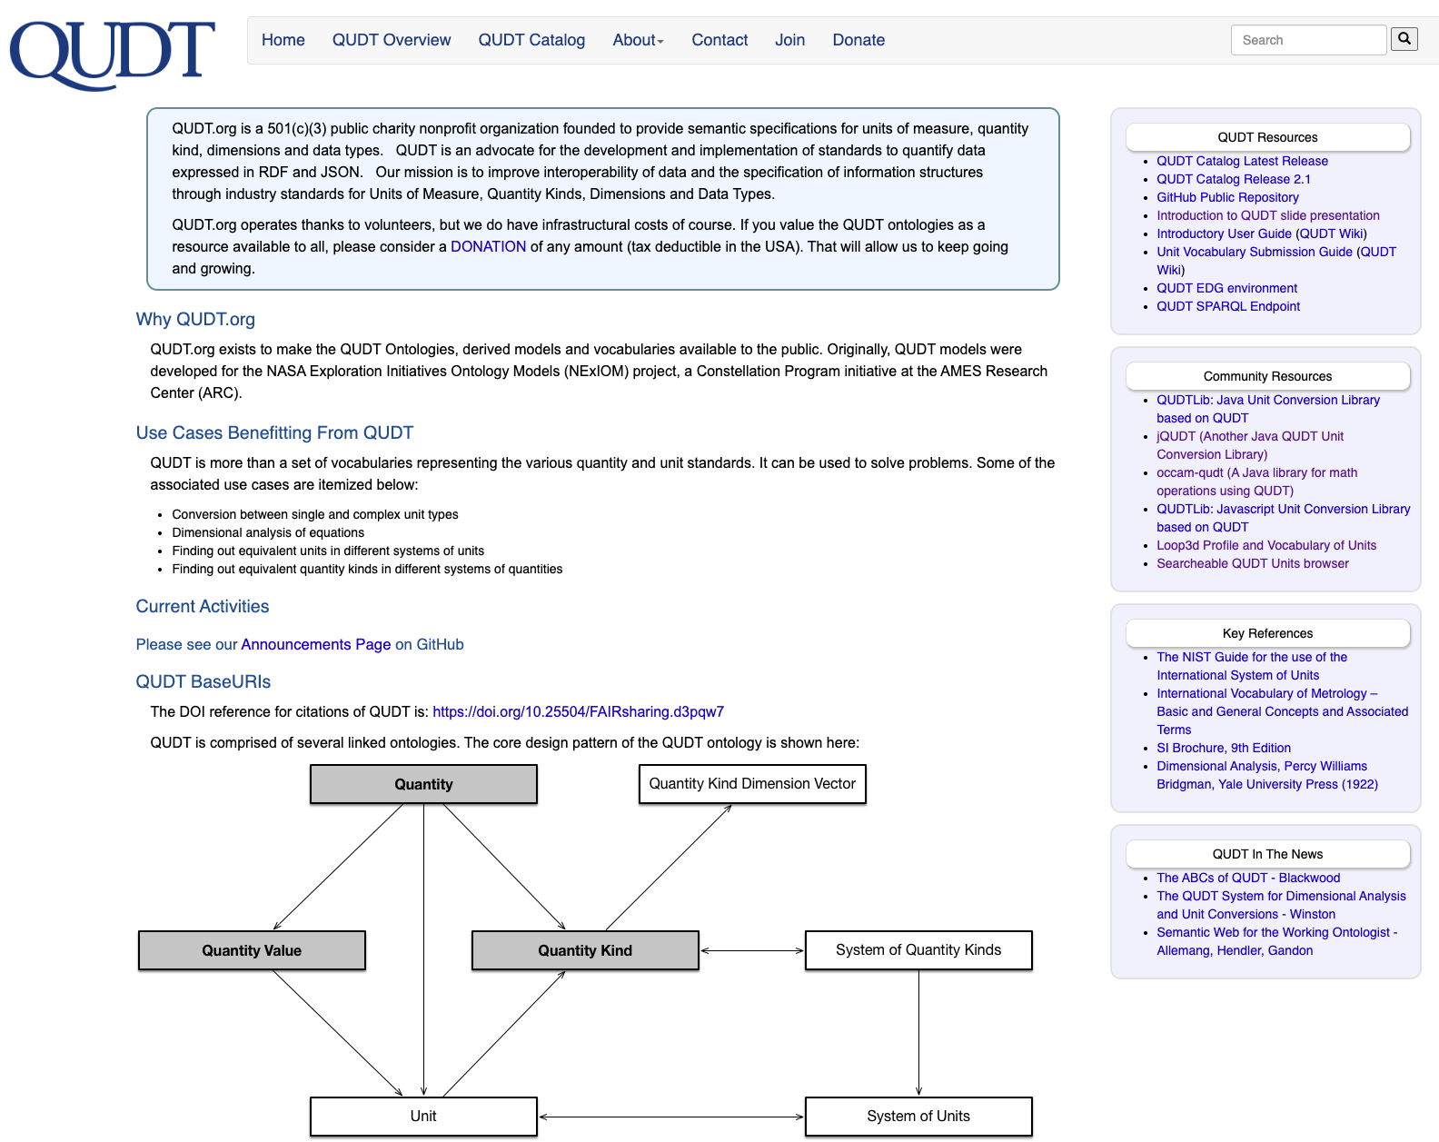
What is QUDT.org?
QUDT.org publishes curated work:
for humans: as QUDT Web pages www.qudt.org
for machines: as RDF/OWL and SHACL Ontologies at www.qudt.org
QUDT enables Web Services
for Conversions
for Error detection - consistency and correctness auditing for engineering reviews, reports and software code
for Dimensional analysis
Notes:
A nonprofit organization, QUDT.org, to represent standards for Units of Measure and Quantity Kinds as machine - processable W3C Linked Data models and vocabularies
Began as a NASA-sponsored project for a “semantically enhanced” version of Standard Engineering Tables

Slide 7
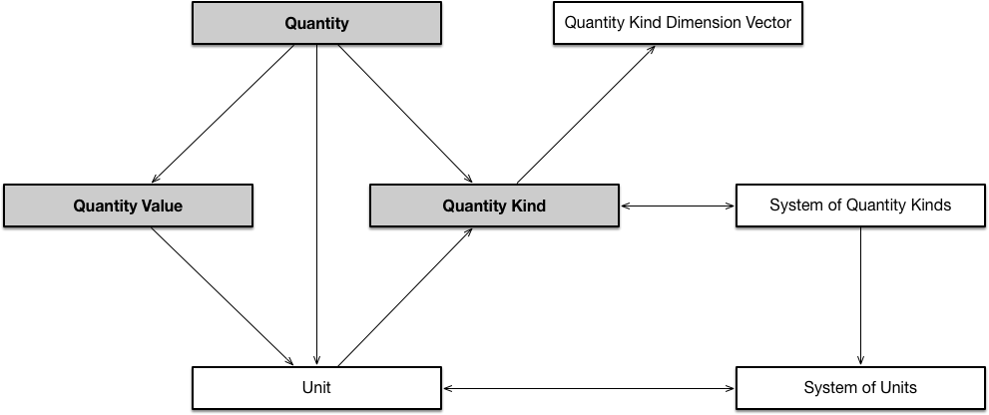
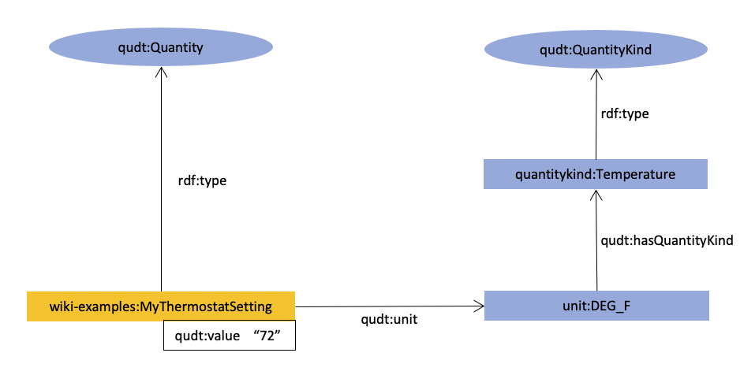
What is QUDT?
Options for alignment between IDO and QUDT classes and vocabularies are being explored
Will lead to improvements to IDO & QUDT
Example data:
Schema

Slide 8
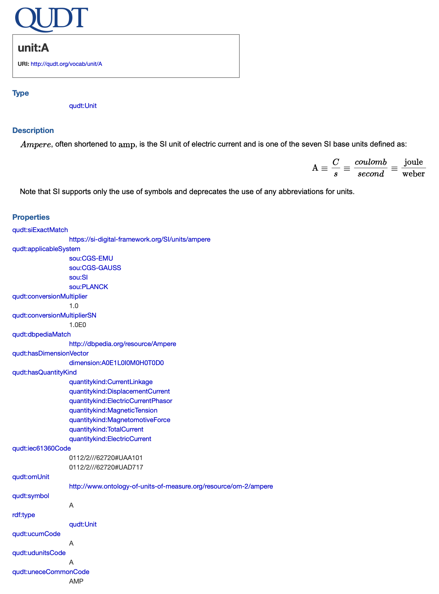
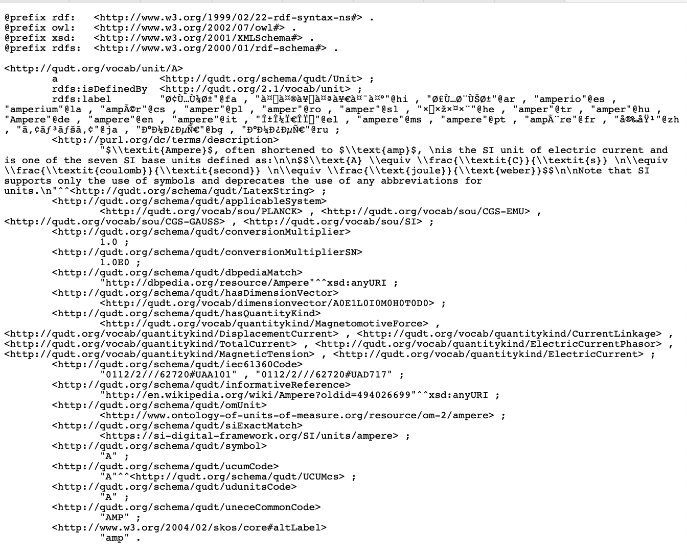
Key Features of QUDT
Exists as a set of FAIR-compliant modular graphs for
Schema (both OWL and SHACL)
Vocabularies of
2807 Units
1169 Quantity Kinds
224 Dimension Vectors (for the 7 SI base dimensions)
328 Physical Constants
11 Systems of Units
10 Systems of Quantity Kinds
Fully resolvable URIs for all vocabulary instances, (with content negotiation), and for the entire graphs
Defined grammar for unit URI names
Encoded as Turtle RDF files
Web-based browsing and SPARQL querying
QUDT is licensed under a Creative Commons Attribution 4.0 International License
https://qudt.org/vocab/unit/A.html
https://qudt.org/vocab/unit/A.ttl

Slide 9
Adoption – Standards Activities
Sample standards activities adopting QUDT
- ASHRAE Standard 223 (Public Review underway) - building automation interoperability standard
- Australia and New Zealand Soil Data Standards
Brick - open source semantic standard for building metadata
- Letter of Intent signed with POSC Caesar Association (PCA)
Harmonization activities
IEC/SC3D
ISO 23726-3 (IDO) with POSC Caesar Association (PCA)
PCA is a candidate as ISO 23726 Maintenance Agency
Cross-references from QUDT
- Digital SI
- IEC 61360
(CDD, Common Data Dictionary)
- UNECE
- UCUM
- OM
- UDUNITS
Cross-references to QUDT
Wikidata
Semantic Arts

Slide 10
Adoption – Sample of Organisations
Commonwealth Scientific and Industrial Research Organisation (CSIRO) - geosciences and ecological research
DSA Data Society Alliance (https://data-society-alliance.org/#top) in Japan (formerly DTA Data Trading Alliance) - Guidelines call for use of QUDT
Siemens - Manufacturing (SCADA), Building Environments and SmartGrid Research, "Digital Twins," Enterprise-wide Ontology Library
Corning - manufacturing line configuration
Australian National Biodiversity data store (under development)
QUDT use is mandated
Environmental Data Initiative (EDI) - mandates QUDT use
See https://github.com/EDIorg/Units-WG
Industrial Ontology Foundry (https://industrialontologies.org/)
Semantic Arts - consulting firm specializing in data-centric transformation

Slide 11
Community Software Contributions
Tools and libraries based on QUDT:
https://github.com/egonw/jqudt
Java Library to deal with QUDT units and conversions between them.
https://github.com/qudtlib/qudtlib-java and https://github.com/qudtlib/qudtlib-js
Java and JavaScript libraries supporting factorization of units
https://github.com/occamsystems/occam-qudt
Java library for math operations using QUDT
Registries and repositories:
- TriplyDB
- LOV
- FAIRSharing.org
- BioPortal
- EcoPortal

Slide 12
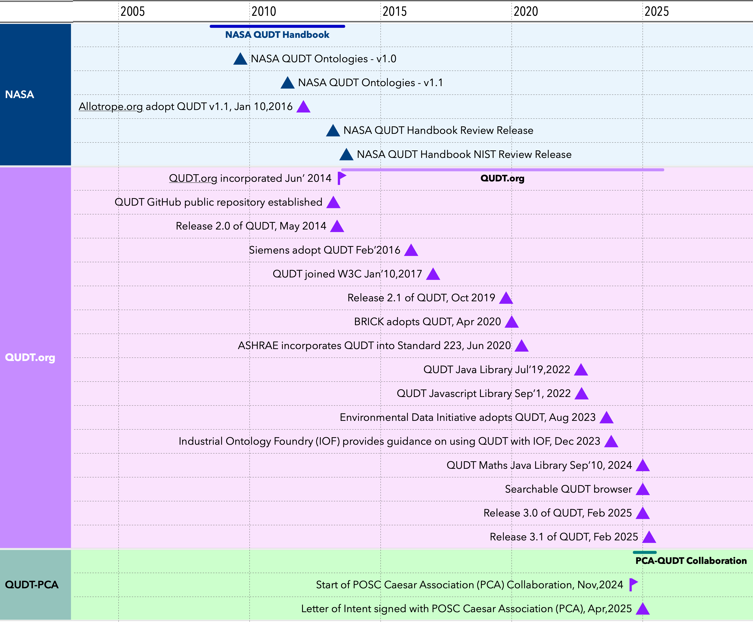

Slide 13
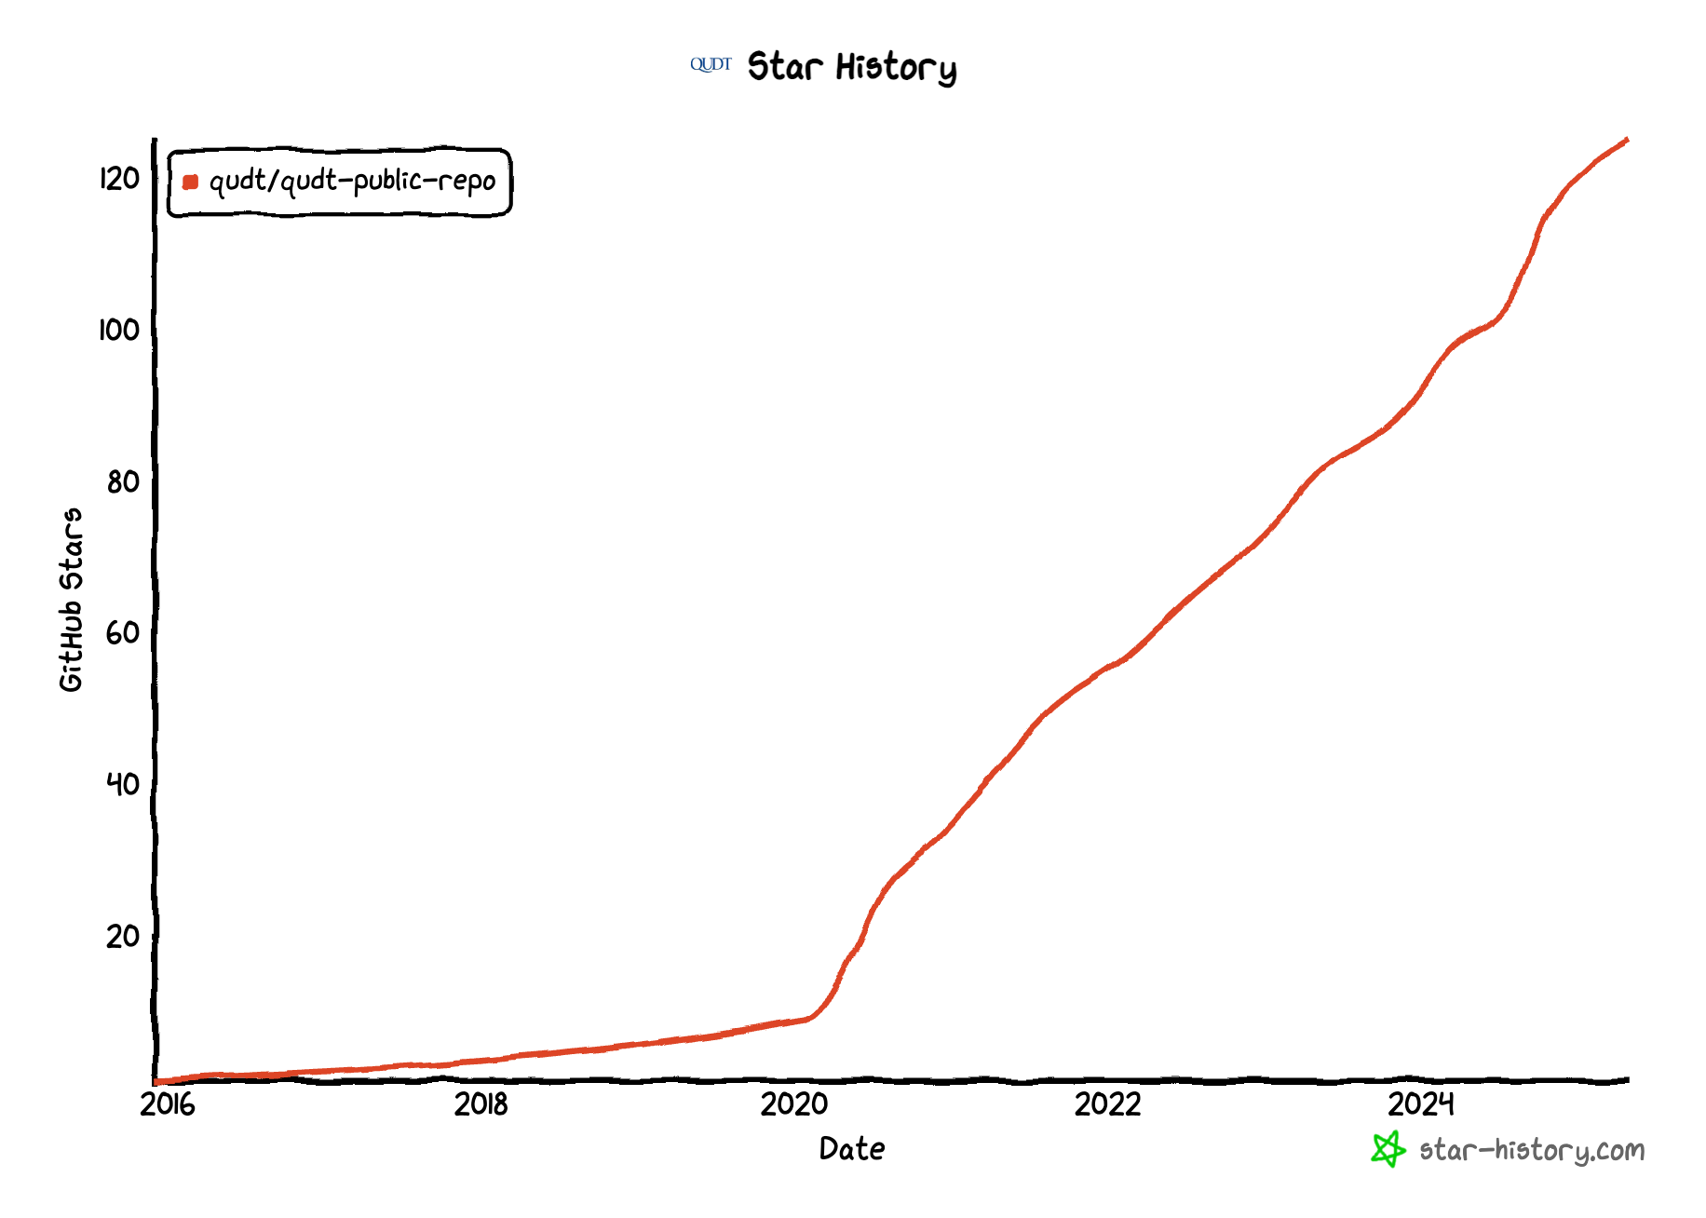
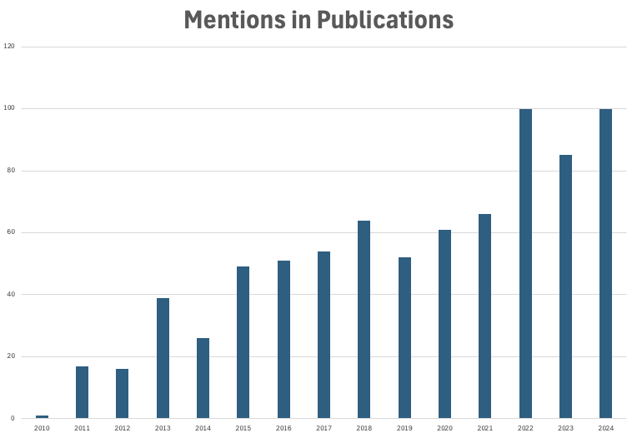
Interest Trends
GitHub “Stars”
Google Scholar

Slide 14
Finding out more …
https://qudt.org – Homepage
https://github.com/qudt/qudt-public-repo – Github repository
https://github.com/qudt/qudt-public-repo/wiki/User-Guide-for-QUDT – User Guide
Email: info@qudt.org

Slide 15
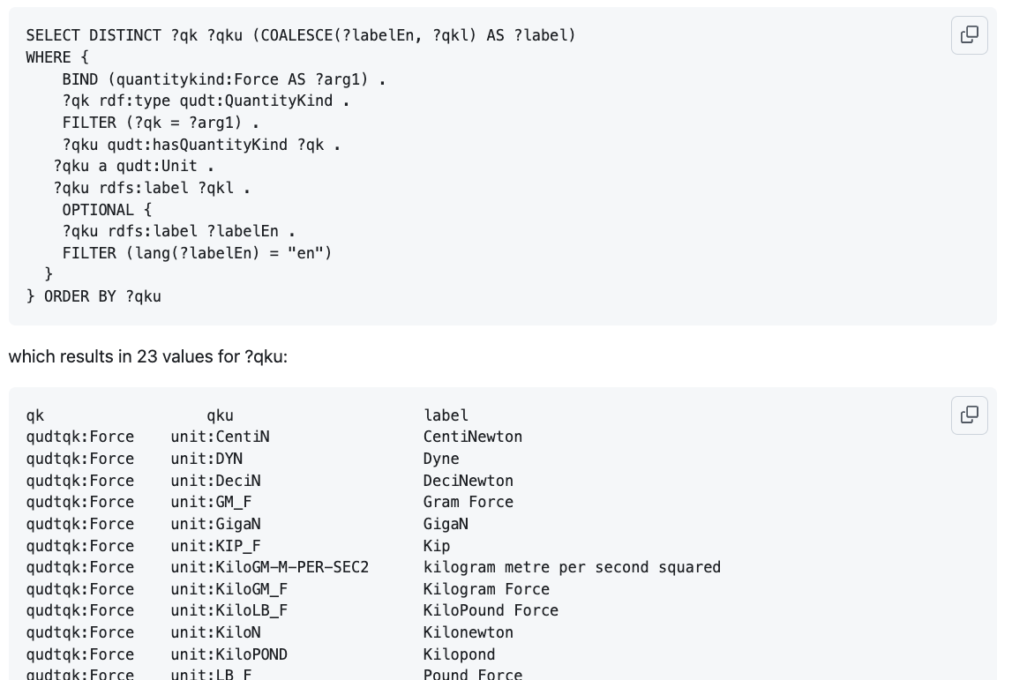
Demo 1: Units of Force

Slide 16
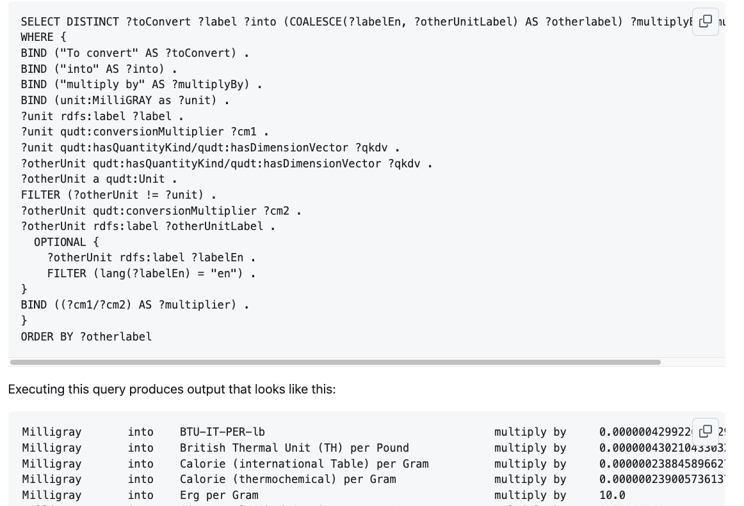
Demo 2: Unit Conversion

Slide 17
Supporting information
QUDT Supports Multiple Communities
F.A.I.R.
Governance Management
Governance Policies, Principles, Processes, Issues, Measures
Quality Assurance
Current Developments

Slide 18
Thank You
Contact us at:
info@qudt.org

Slide 19
QUDT Supports Multiple Communities
Linked Data community
Resolvable URIs for graphs and individuals
Continuously updated
Industrial User community
Versioning of Releases for embedding and managing within industrial applications
Choice of OWL or SHACL representation for the schemas
Explicit or dynamically inferred (SHACL) properties
E.g. “applicableUnits” for each QuantityKind
Available for use with or without the need for reasoners
Future standards should keep these disparate needs in mind

Slide 20
F.A.I.R.
1. The FAIR Guiding Principles
Findable
Globally unique identifiers for all concepts
Metadata specified for each schema and vocabulary graph
QUDT is registered with DOI, FAIRSharing.org, LOV, TriplyDB, BioPortal
QUDT is cross-referenced by WikiData
Accessible
A website is published at https://qudt.org/
A SPARQL endpoint is available at http://www.qudt.org/fuseki
A commercial exploration tool is available at http://www.qudt.org/edg/tbl
All graphs, classes and vocabulary instances are resolvable on the web
Interoperable
All artifacts are represented in standard languages
All vocabularies are expressed using RDF (Resource Description Framework)
QUDT schemas are expressed in both OWL and SHACL
Includes cross-references to Digital SI, UCUM, UN-ECE, OM, IEC 61360, UDUNITS codes
Reusable
Licensed under Creative Commons Attribution 4.0 International License
Definitions are provided with normative and informative references
2. Symbols consistent with NIST SP811
3. Naming rules - as documented on GitHub Wiki

Slide 21
Governance Management
Provenance
Provenance - source and expressions of derivation including supercedence
"Nothing gets deleted unless it is incorrect"
Existing non-conformant URIs remain, but equivalent conformant URIs are added
Traceability
to other units of measure vocabularies: UCUM, UNECE, OM, IEC 61360
to normative and informative references, including SI Brochure – 9th Edition, ISO-80000, NIST SP811
to compliance assurance certification verification and validation
Governance Processes
Versioning and Configuration Management
Named graphs with major.minor.point identifiers for releases
Frequent repository updates using GitHub Pull Request mechanism
Release schedule approximately every 1-2 months or after major changes
Submission & Approval process
Uses the GitHub Issues/Pull Request mechanism
Review/approval required by at least one Board member
Notification Processes
Announcements on QUDT.org website and on GitHub
Discussion posts on the QUDT GitHub repository using Issues, Pull Requests, and GitHub Discussions

Slide 22
Governance Policies, Principles, Processes, Issues, Measures
Governance Policies
Adherence to procedures for compliance with our legal status as a 501(c)(3) Non-profit charity, incorporated in the state of California
Managed submission
Adherence, where possible, to well-established symbols for units of measure, expressed in Unicode
Grammar-based construction of UoM QNames

Slide 23
Quality Assurance
Issue Resolution
Strategic - handled by QUDT.org Board
Technical - handled by Technical Advisory Board (TAB) when needed
Quality Processes
How QUDT content is assessed for completeness, consistency and correctness
(SPARQL) Queries for QA V&V
Validation checks using (SHACL) rules
Continuous Integration (CI) workflow
Quality Measures
consistency
completeness
correctness
compliance

Slide 24
Current Developments
Profiles
Community-Driven subsets of units and quantity kinds appropriate to domains and disciplines
Compact Unique Identifiers
for telemetry, bandwidth-limited or memory-limited devices
Build Automation
Validation
Web page publication
Release generation

